Slide 1
Hotel Chain Analytics
Platform
Course - CIS 444/544 Professor: Flint Million Group 5: Meena, Kavaughn, Yu
Data Analytics | Spring 2026

Slide 2
Business Context
245
623K
8.9M
29M+
Properties
Customers
Transactions
Line Items
Hotel Operations
Gift Shop Operations
Source: SQL Server
Rooms, reservations, payroll, amenities
Multi-property structure with 245 locations
Core transactional and revenue data
Source: MongoDB
Collections: shops, products, transactions
Flexible schema with nested documents
Cross-source revenue comparison enabled

Slide 3
Business Questions
11 analytics questions driving warehouse design and dashboard development
1
Monthly revenue by property
2
Revenue by product/service type
3
Check-in volume trends over time
4
Customer spending patterns
5
Room pricing analysis
6
Payment method usage breakdown
7
Hotel vs. gift shop revenue (cross-source)
8
Top gift shop categories
9
Weekend vs. weekday check-ins
10
Labor costs vs. revenue ratios
11
Amenities vs. revenue correlation

Slide 4
Data Architecture
Source → ETL → Warehouse → Dashboard pipeline
Data Sources
Python ETL
HotelDW
Dashboard
SQL Server
cis44
pyodbc
Dimensions
Streamlit
MongoDB
cis444
pymongo
Fact Tables
Plotly
Incremental
Tracking
DGDB
Governance
4 Analytics
Tabs

Slide 5
Star Schema Design
Fact tables across HotelDW - purpose-built for each analytics domain
fact_revenue
Dimensions:
dim_date · dim_property · dim_customer · dim_room_type
Grain: Transaction line item
fact_checkin
Dimensions:
dim_date · dim_property · dim_customer
Grain: Check-in event
fact_gift_shop_sales
Dimensions:
dim_date · dim_property · dim_shop · dim_gift_product
Grain: Gift shop line item
fact_payroll
Dimensions:
dim_date · dim_property · dim_employee
Grain: Payroll record
fact_property_amenity
Dimensions:
dim_property · dim_amenity
Grain: Property-amenity mapping

Slide 6
LIVE DASHBOARD DEMO
Streamlit + Plotly - Interactive Analytics
01
02
03
04
Executive Overview
Operations & Staffing
Gift Shop Analytics
Amenities & Trends
KPIs, revenue trend, payment breakdown, top properties
Labor cost ratios, weekend vs. weekday patterns
Cross-source comparison, category performance
Amenity impact analysis, seasonal heatmap
Filters: Date Range · Property Selector · Top-N · 3 Computed Measures (YoY, Labor Cost %, Gift Shop %)

Slide 7
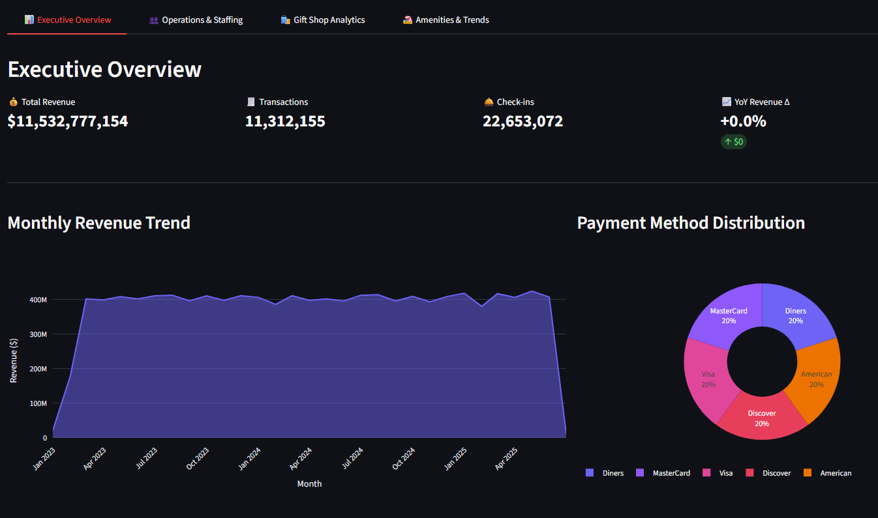
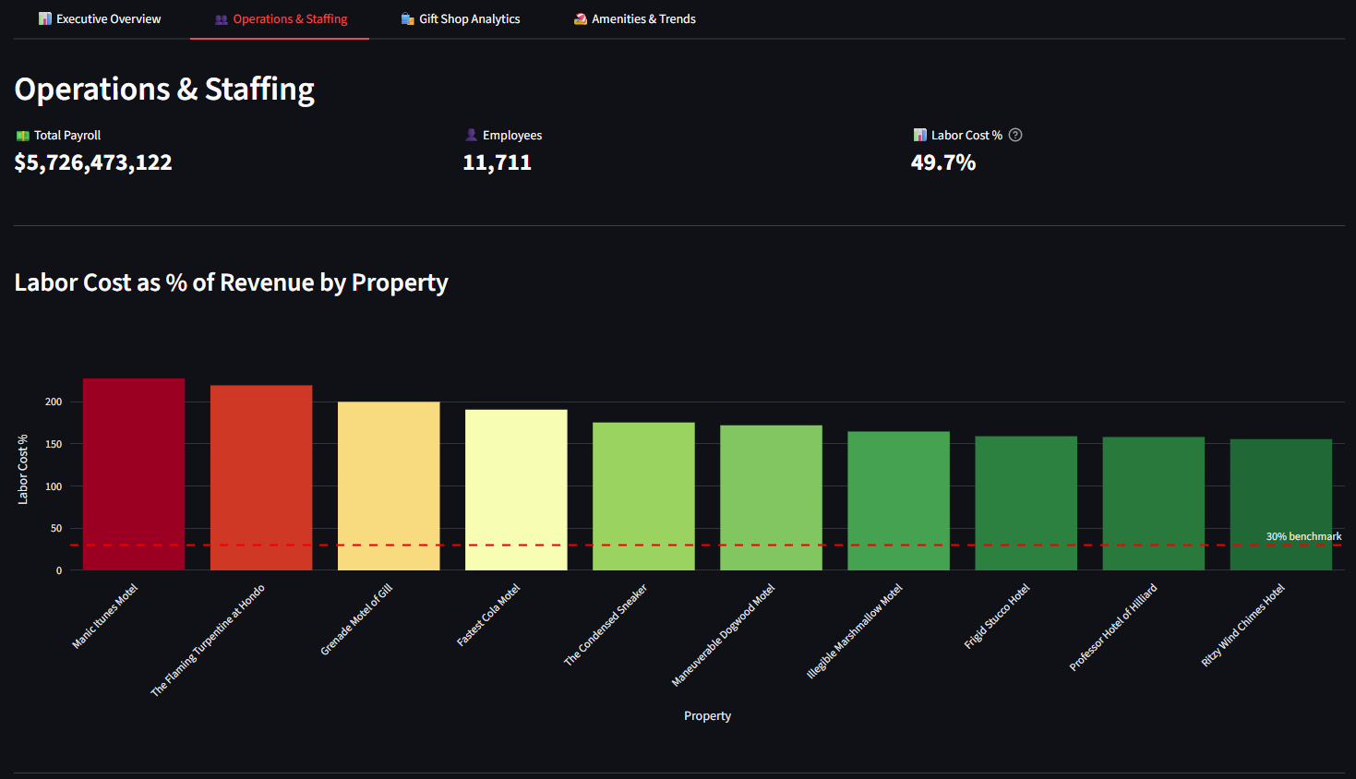
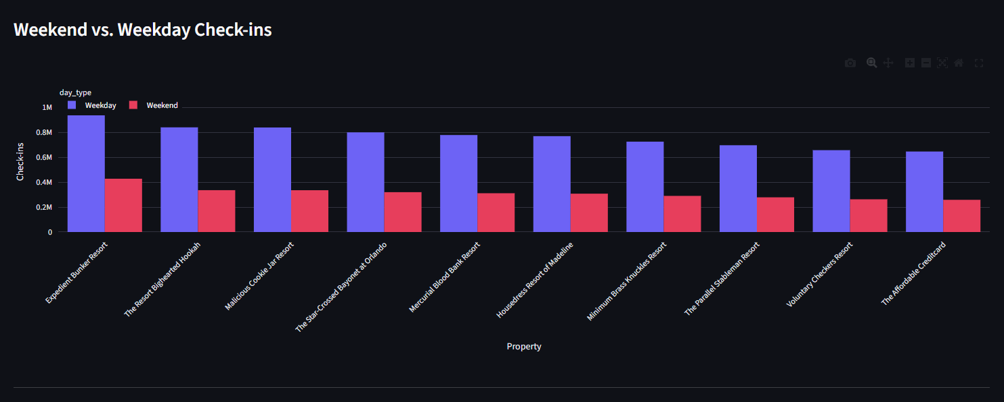
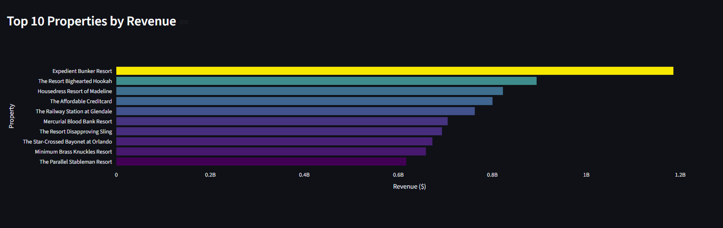
Dashboard Screenshots
Executive Overview
Operations & Staffing

Slide 8
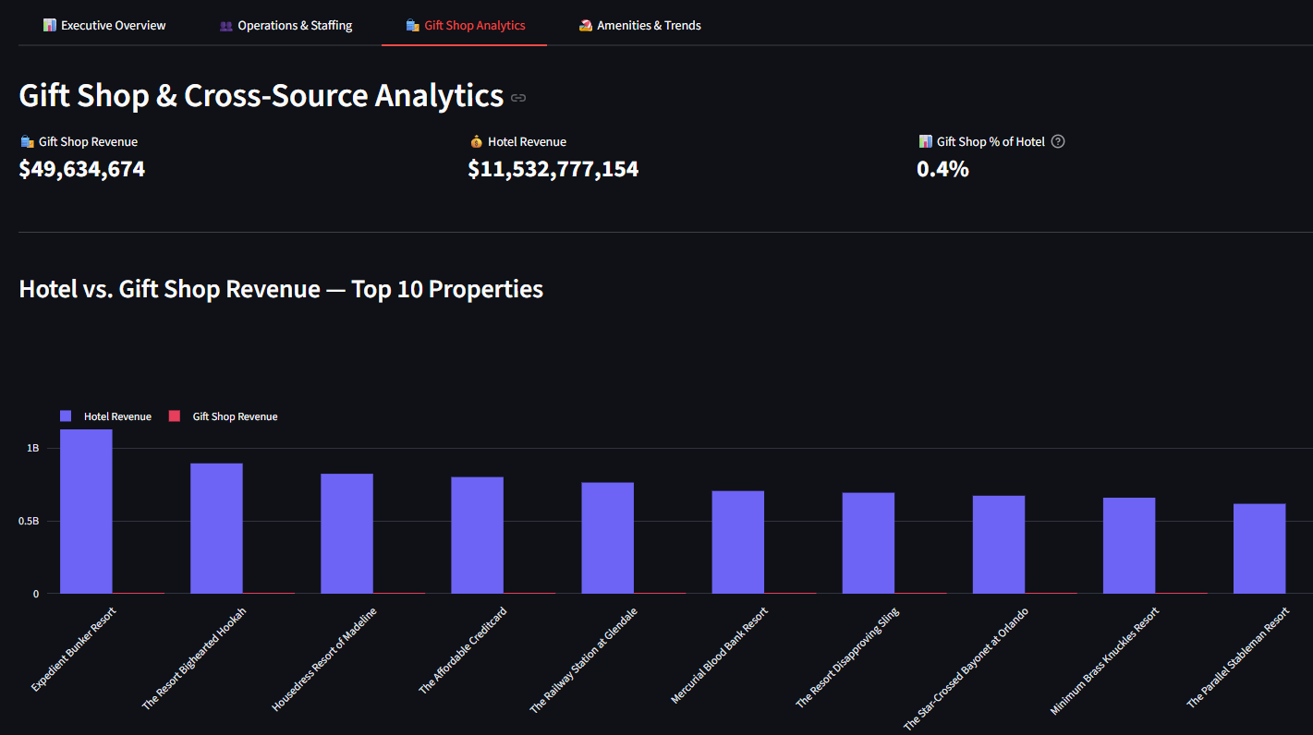
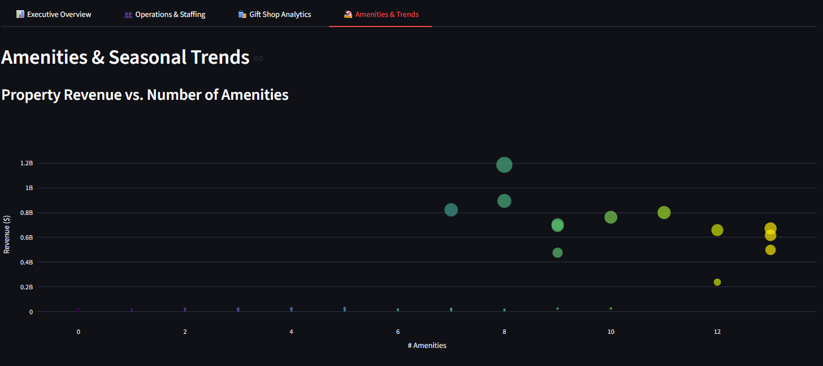
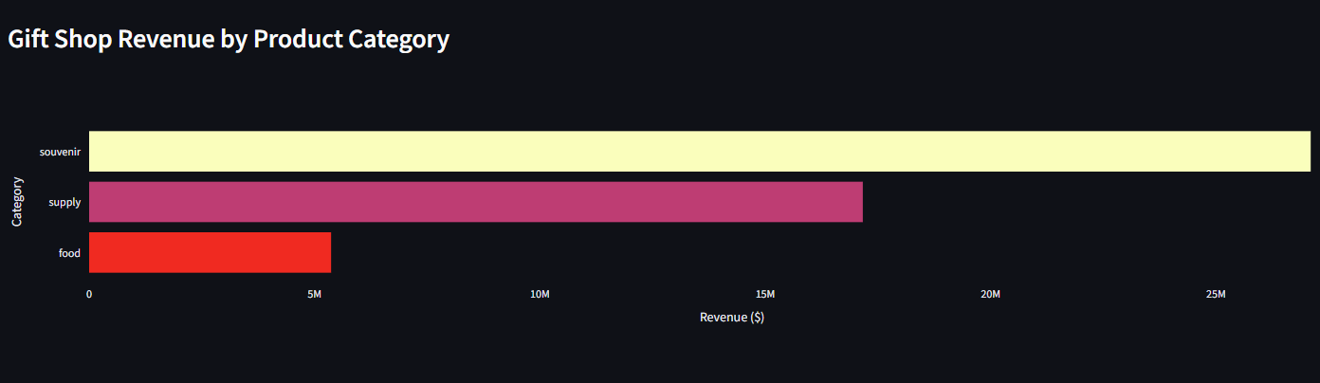
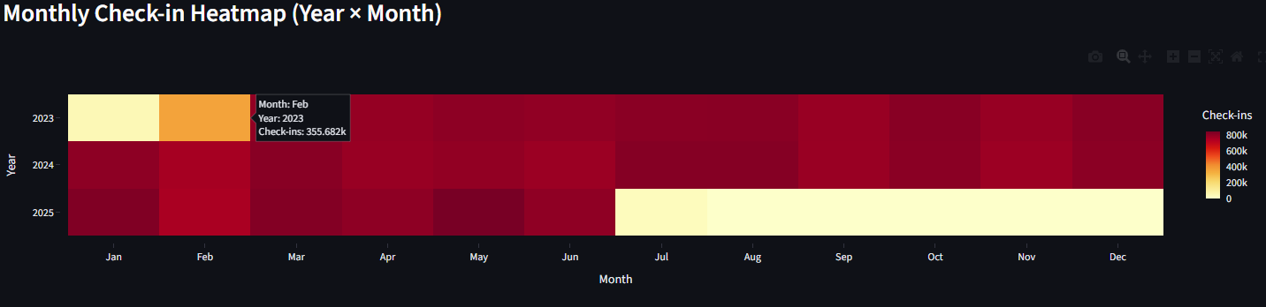
Dashboard Screenshots
Gift Shop Analytics
Amenities & Trends

Slide 9
Key Findings
Insights derived from the HotelDW analytics platform
1
Revenue Concentration
Top 10 properties account for a disproportionate share of total revenue - high-value asset focus opportunity.
2
Labor Efficiency
Properties with labor cost ratio > 30% are candidates for staffing optimization reviews.
3
Gift Shop Impact
Cross-source analysis reveals gift shop contribution to total revenue - previously invisible in siloed systems.
4
Seasonal Patterns
Check-in volume shows clear seasonal peaks and troughs enabling proactive staffing and pricing decisions.
5
Amenity Correlation
Properties with a broader amenity portfolio tend to generate higher revenue per customer visit.

Slide 10
Data Product: Gift Shop Open Dataset
PII-free data mart designed for external sharing and research
Dataset Contents
Privacy Protections
Database: GiftShopOpenDataset
All customer PII removed
Transaction IDs re-sequenced (non-correlatable)
Exported via SSMS as .sql file
properties
Hotel property metadata (no PII)
products
Gift product catalog and categories
Use Cases
Product performance benchmarking
Regional sales comparisons
Pricing strategy research
Academic / external analytics
transactions
Re-sequenced IDs, no customer linkage

Slide 11
Data Governance
Sprint 5: DGDB integration - Validation and audit logging
DGDB Tables
4 Validation Rules
ETL_Runs
1
Referential Integrity
→ Start/end timestamps per run
FK checks across all dimension-fact joins
→ Rows affected per table
2
Null Checks
→ Status (pass/fail)
Required columns validated before load
Validation_Results
Date Range Validity
3
→ Rule ID + description
All dates within expected operational window
→ Row-level pass/fail counts
→ Timestamp + ETL run link
4
Numeric Range
Revenue, cost, and count values within bounds

Slide 12
Sprint-by-Sprint Journey
6 sprints from discovery to production-ready analytics platform
Sprint 1
Sprint 2
Sprint 3
Discovery
MongoDB + DW Design
DW Population
ERD, data dictionary, 6 initial queries
ETL to MongoDB, star schema DDL
Cross-source ETL, date dimension
Sprint 4
Sprint 5
Sprint 6
Optimization
Data Governance
Dashboard + Data Product
Incremental ETL, Streamlit POC, new schemas
DGDB, validation rules, audit logging
9-viz dashboard, PII-free dataset, presentation

Slide 13
Reflection & Lessons Learned
What Went Well
Challenges
Lessons Learned
Incremental ETL design scaled cleanly across all 6 sprints
Remote SQL Server timeouts - solved via connection-per-batch pattern
Data governance is easier built-in than retrofitted later
Cross-source SQL Server + MongoDB integration unlocked richer analytics
MongoDB schema flexibility required careful data validation at load time
Star schema decisions have cascading impact on all downstream analytics
Streamlit + Plotly enabled rapid, professional dashboard development
29M+ row datasets required batch processing optimization for performance
Interactive dashboards deliver far more value than static reports

Slide 14


